Slide 1



N E W S L E TTE R
2 02 5 - 1 - D E 02 - K A 2 1 0 - V E T - 0003 5 03 4 2
P A W S I T I V E I M P A C T : S O L I D A R I T Y T O U R I S M A N D A N I M A L T H E R A P Y
P A W S I T I V E I M P A C T P R O J E C T K I C K S O F F I N I T A L Y
The Pawsitive Impact: Solidarity Tourism and Animal Therapy project officially launched with a successful kick-off meeting held in Bologna, Italy, on 25–26 October 2025.
PARTNERS
Hosted by our Italian partner Igor Vitale International, the meeting brought together all project partners: Edupals (Germany) as coordinator and Mykonos International Initiative (Greece). This first transnational
meeting marked the beginning of a two-year collaboration focused on innovation in vocational education, animal welfare, and sustainable tourism.

Slide 2
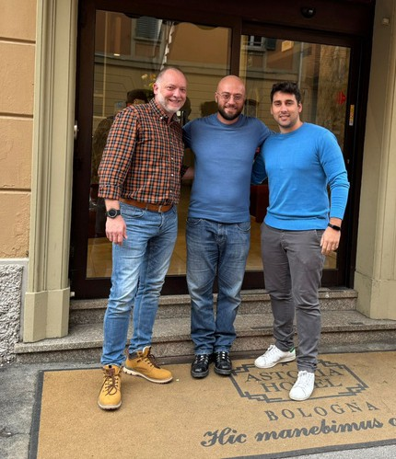
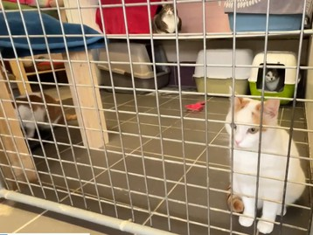
N E W S L E TTE R
2 02 5 - 1 - D E 02 - K A 2 1 0 - V E T - 0003 5 03 4 2
P A W S I T I V E I M P A C T : S O L I D A R I T Y T O U R I S M A N D A N I M A L T H E R A P Y
P A W S I T I V E I M P A C T P R O J E C T K I C K S
During the first day, project partners came together to align on the project’s objectives, define roles and responsibilities, and plan the upcoming activities. This initial coordination ensured a shared vision and a structured approach for the implementation phase, setting a strong foundation for effective collaboration among all partners.
O F F I N I T A L Y
The second day was dedicated to a workshop titled “Animal Assisted Therapy: A Symbiotic Healing Space – Transferability in Solidarity Tourism.” The session explored how animal-assisted therapy can be integrated into ethical and socially responsible tourism practices, highlighting its potential to create meaningful experiences for participants while supporting animal welfare and community engagement.

Slide 3
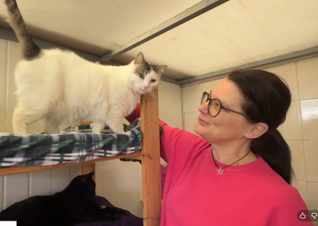
N E W S L E TTE R
2 02 5 - 1 - D E 02 - K A 2 1 0 - V E T - 0003 5 03 4 2
P A W S I T I V E I M P A C T : S O L I D A R I T Y T O U R I S M A N D A N I M A L T H E R A P Y
P A W S I T I V E I M P A C T P R O J E C T K I C K S
As part of the programme, participants visited Mačja Preja, a small animal rescue and cat shelter located near Koper, on the Italian-Slovenian border. The visit provided valuable insights into the shelter’s operational model, particularly in terms of animal care practices and the interaction between animals and visitors. This hands-on experience helped bridge theory and practice, offering inspiration for the project’s future activities.
O F F I N I T A L Y
Over the next two years, the project will focus on developing a practical handbook for trainers and professionals, creating a digital training pathway to support the ethical integration of animal-assisted therapy into tourism, and designing an AI-based matching system to connect individuals with animals for adoption or therapeutic engagement.

Slide 4

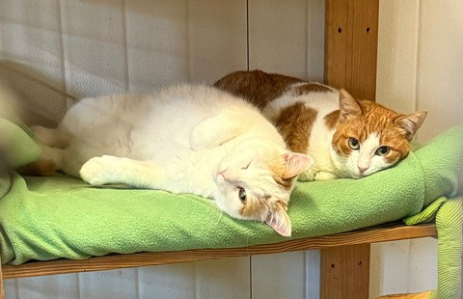
N E W S L E TTE R
2 02 5 - 1 - D E 02 - K A 2 1 0 - V E T - 0003 5 03 4 2
P A W S I T I V E I M P A C T : S O L I D A R I T Y T O U R I S M A N D A N I M A L T H E R A P Y
P A W S I T I V E I M P A C T P R O J E C T
Reflecting on the progress made since the kick-off meeting, the partnership is confident that Pawsitive Impact will generate meaningful and innovative outcomes, benefiting both communities and animals while promoting more responsible and inclusive tourism practices.
K I C K S O F F I N I T A L Y
Pawsitive Impact pawsitiverasmus
www.pawsitiveimpact.eu

